Slide 1
DOM

Slide 2
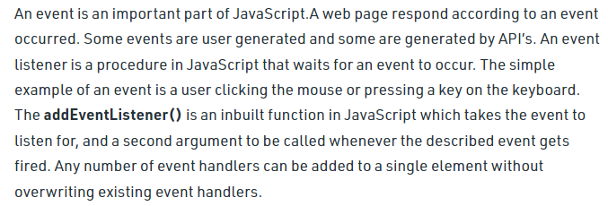
Events

Slide 3

Events

Slide 4
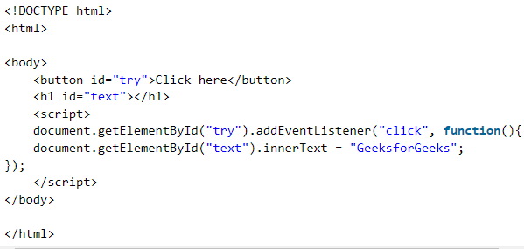
Events

Slide 5
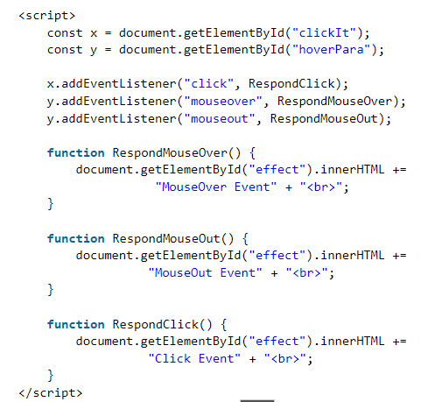
Events

Slide 6

Events

Slide 7
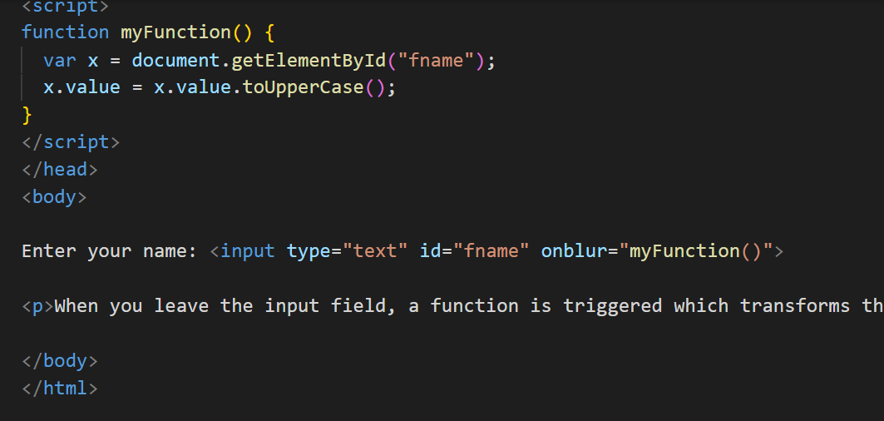
onBlur

Slide 8
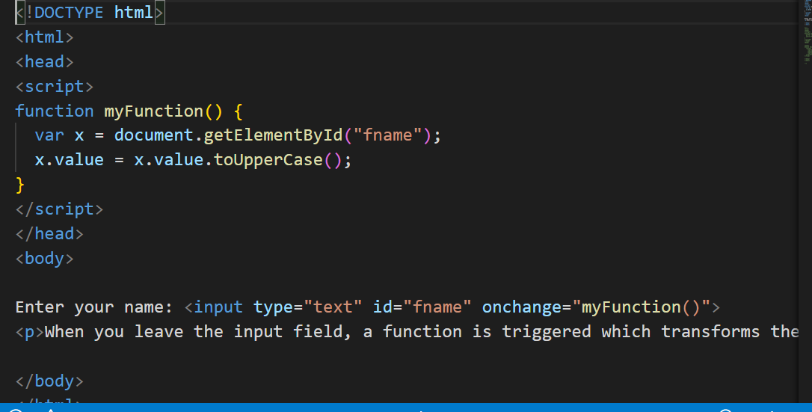
onChange

Slide 9

Difference Between onBlur and onChange

Slide 10
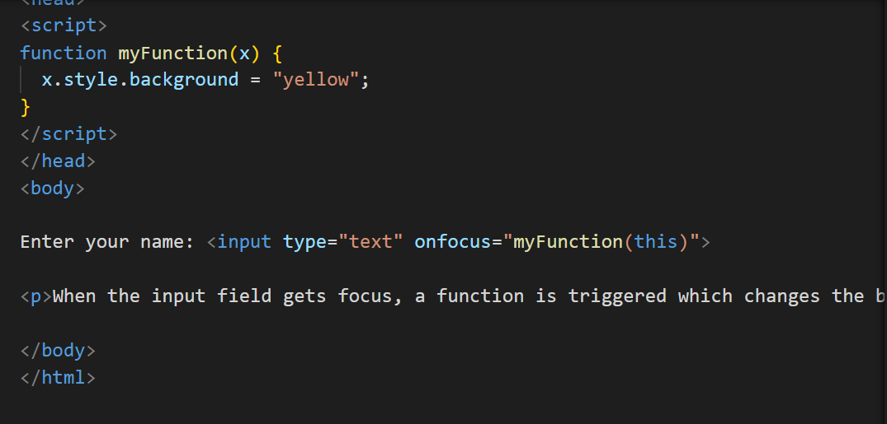
onFocus

Slide 11
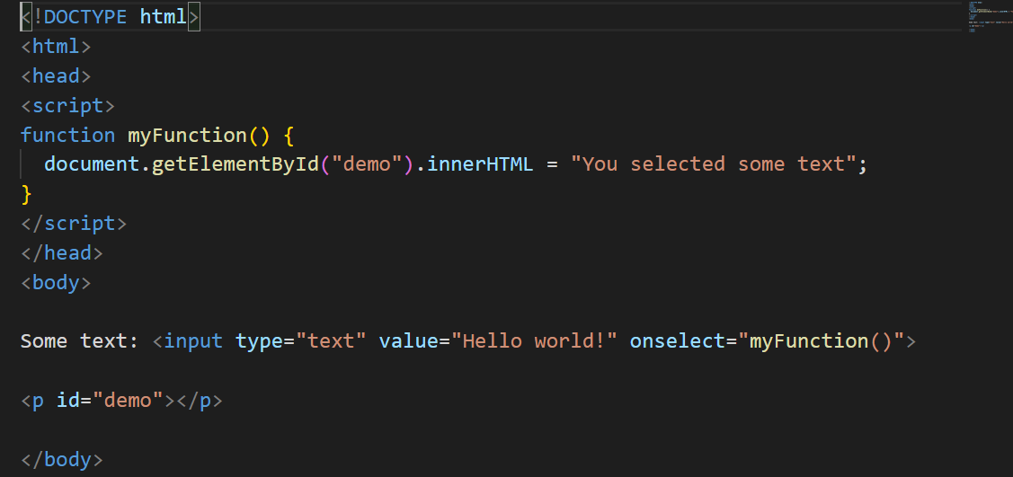
onSelect

Slide 12
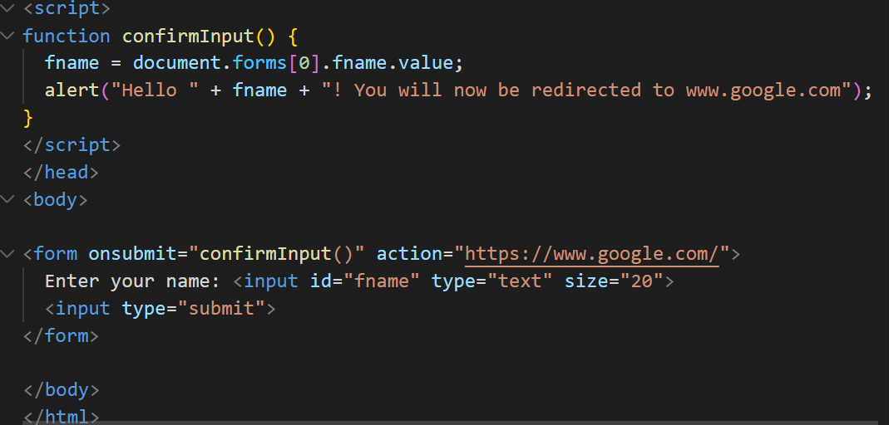
onSubmit

Slide 13
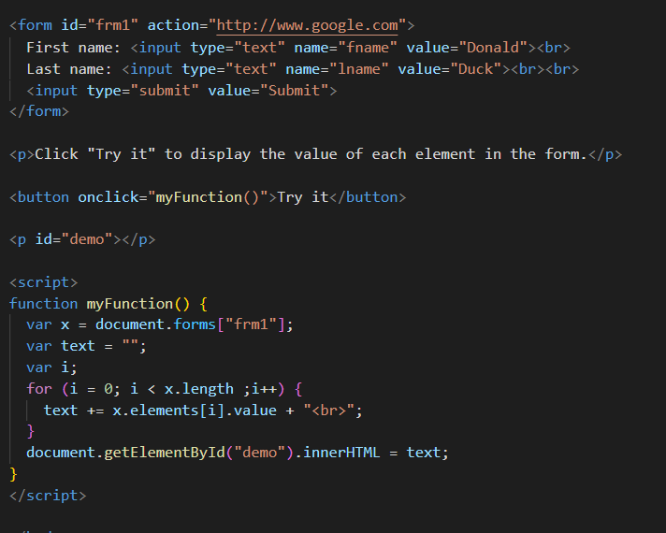
Form Object Collection

Slide 14
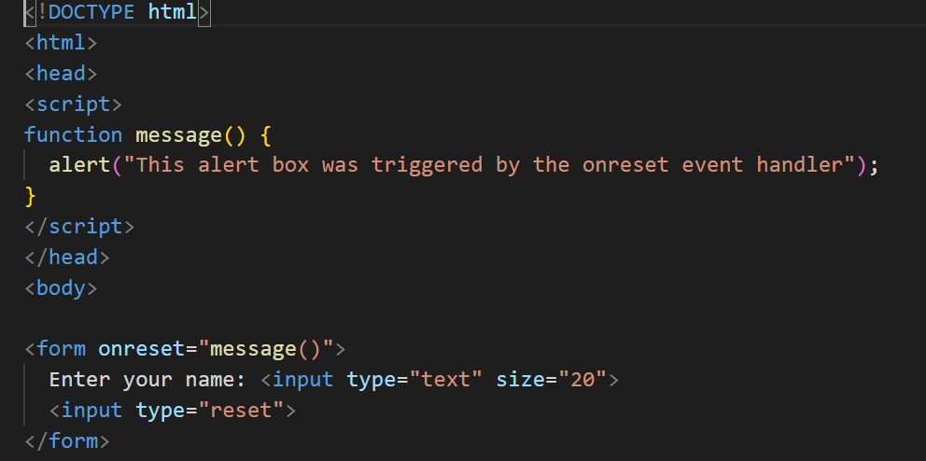
onReset

